Slide 1
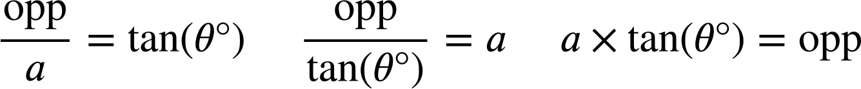
Using the tangent ratio
Task A: Formalising the tangent formula
1) Substitute the labelled sides and angle in each triangle into these two versions of the tangent formula.
For each triangle, choose the most appropriate version of the tangent formula to find the length of its missing side.
× tan( ) =
× tan( ) =
a
81°
119
2
49°
b
49°
119
a
119 cm
b
2
2 cm
b cm
tan( )
=
tan( )
=
81°
49°
a cm = 18.85 cm
81°
b cm = 2.30 cm
a cm
2) Match the triangle to the equation showing the relationship between its adjacent and the opposite side.
Use the equation to find the length of the missing side labelled x on each triangle (2 d.p.)
a)
b)
c)
x cm
32 cm
50°
32°
x cm
32°
50 cm
x cm
50 cm
50 × tan(32°) = x
e
32 × tan(50°) = x
f
x × tan(32°) = 50
d
x = 31.24
x = 38.14
x = 80.02
The side opposite 32° has a length of 31.24 cm
The side opposite 50° has a length of 38.14 cm
The adjacent has a length of 80.02 cm

Slide 2
Using the tangent ratio
3) By using the tangent formula, find the length of the missing side labelled with a letter for each of these triangles (2 d.p.)
a)
b)
c)
a cm
b cm
c cm
39°
39°
49°
1 cm
a = 0.81
14.9 cm
b = 12.07
14.9 cm
c = 17.14
d)
e)
f)
14.9 cm
41°
e cm
49°
49 cm
14.9°
d cm
d = 12.95
14.9 cm
e = 17.14
f = 184.16
f cm
4) Find the lengths of the distances a, b, c, and d (rounded to the nearest integer).
45 cm
64 cm
25 cm
39.5 cm
c cm
a cm
27°
50 cm
b cm
10 cm
d cm
28 cm
38 cm
Task B: Calculating the angle
angle | sine | cosine | tangent
0 | 0 | 1 | 0
5 | 0.087 | 0.996 | 0.087
10 | 0.174 | 0.985 | 0.176
15 | 0.259 | 0.966 | 0.268
20 | 0.342 | 0.94 | 0.364
25 | 0.423 | 0.906 | 0.466
30 | 0.5 | 0.866 | 0.577
35 | 0.574 | 0.819 | 0.7
40 | 0.643 | 0.766 | 0.839
45 | 0.707 | 0.707 | 1
50 | 0.766 | 0.643 | 1.192
55 | 0.819 | 0.574 | 1.428
60 | 0.866 | 0.5 | 1.732
65 | 0.906 | 0.423 | 2.145
1) Use the table of values to work out the missing angle in each triangle.
a)
b)
8.39 cm
21.65 cm
40°
10 cm
60°
c)
d)
12.5 cm
45°
5 mm
20 m
7.28 m
5 mm
20°

Slide 3
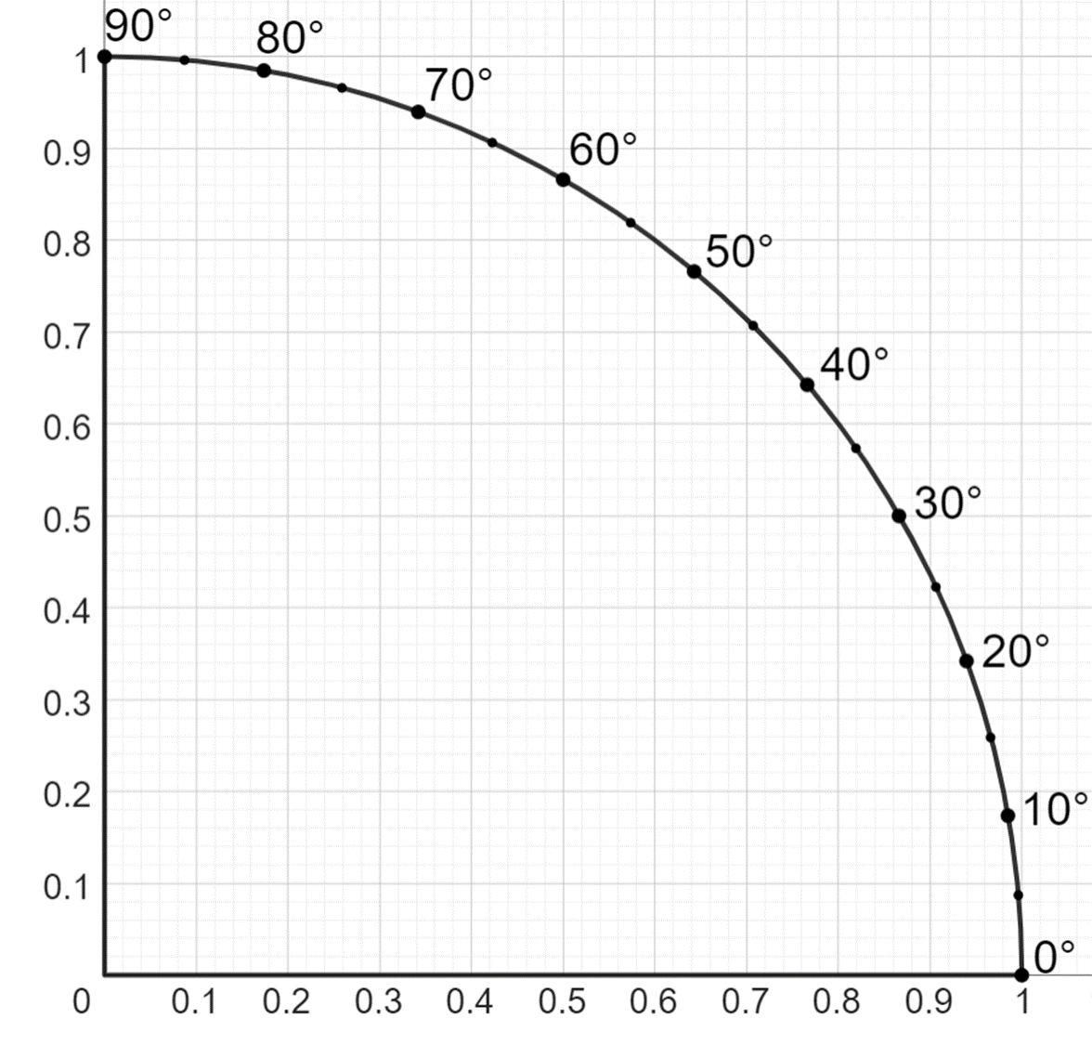
Using the tangent ratio
2) By drawing the appropriate lines on to the graph, estimate the angle in each triangle.
a)
8 cm
b)
38.7°
a)
10 cm
Approximate answers acceptable.
b)
45.6°
80 mm
81.6 mm
3) Use your calculator to work out the missing angle in each triangle, giving your answer to 1 decimal place.
a)
b)
8 cm
3.2 m
70.2°
38.7°
10 cm
8.9 m
c)
d)
121 cm
45.6°
80 mm
59 cm
26.0°
81.6 mm
Mathematics in Education and Industry.

